Slide 1
Real-Time
Crowd Simulation
Milestone 1
Ashley Alexander-Lee, Matt Elser, Wayne Wu

Slide 2
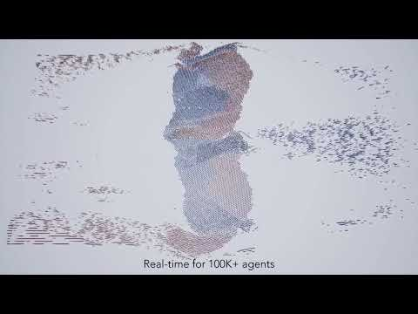
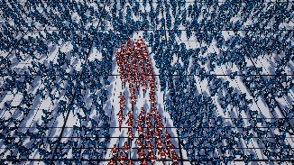
OVERVIEW
A real-time crowd simulation based on “Position-Based Multi-Agent Dynamics for Real-Time Crowd Simulation” (2018) implemented in WebGPU.

Slide 3
MILESTONE 1 GOALS
Set up render pipelines and basic scene
Set up compute pipelines with passable buffers
Scatter instanced “agent” objects
Set up basic agent simulation

Slide 4
PROGRESS

Slide 5
What’s Next?
Stage | Date | Desired Goal
Milestone 1 | Nov 17, 2021 | Learn WebGPU and get the graphics and compute pipeline working in WebGPU.
Milestone 2 | Nov 29, 2021 | Implement the core algorithm of the paper in the compute shaders (e.g. PBD, hash-grid neighbor searching)
Milestone 3 | Dec 6, 2021 | Replace agents with GLTF characters. Fine-tune simulation parameters.
Final Project Due | Dec 12, 2021 | Visual fine-tuning, performance analysis, README.

